Slide 1
Emotional Loneliness First Aid Infographics
Here is where this template begins

Slide 2
ABOUT EMOTIONAL LONELINESS FIRST AID INFOGRAPHICS
This template contains an assortment of complementary infographic resources for the Emotional Loneliness First Aid presentation.
These infographics are adapted to the style of the aforementioned presentation, so you can insert them easily and have them completely integrated at once. You just need to do the following:
Select the element that you want to copy
Right-click and choose “Copy”
Go to the slide where you want the element to appear
Right-click and choose “Paste”

Slide 3
EMOTIONAL LONELINESS FIRST AID INFOGRAPHICS
EMOTIONAL LONELINESS
SUBJECTIVE
ME
NEGATIVE
Emotional loneliness refers to the feeling of being disconnected or isolated from others
DISCONNECTED
ISOLATED
OTHERS

Slide 4
EMOTIONAL LONELINESS FIRST AID INFOGRAPHICS
EMOTIONAL LONELINESS
Can occur in any type of relationship
ROMANTIC
FAMILY
SOCIAL
Mercury is the smallest planet of them all
Despite being red, Mars is a very cold place
Jupiter is the biggest planet in the Solar System

Slide 5
EMOTIONAL LONELINESS FIRST AID INFOGRAPHICS
MENTAL HEALTH
Despite being red, Mars is a very cold place
NEGATIVE EFFECTS
PHYSICAL HEALTH
Mercury is the smallest planet of them all

Slide 6
EMOTIONAL LONELINESS FIRST AID INFOGRAPHICS
IMPORTANCE OF EMOTIONAL SUPPORT
Reduces stress | Provides comfort and security
Promotes resilience | Helps individuals overcome adversity
Enhances self-esteem | Increases feelings of value and support
Improves mental health | Can help manage symptoms of depression or anxiety
Strengthens relationships | Builds strong, healthy relationships
Boosts physical health | Reduce blood pressure and improve immune function

Slide 7
EMOTIONAL LONELINESS FIRST AID INFOGRAPHICS
RELATIONSHIPS
COMMUNICATION
Jupiter is a gas giant and the biggest planet
Neptune is the farthest planet from the Sun
CAUSES OF EMOTIONAL LONELINESS
BREAKDOWNS
TRANSITIONS
Mercury is the closest planet to the Sun
Despite being red, Mars is a cold place
MENTAL HEALTH
TRAUMAS
Venus has a beautiful name but is hot
Pluto is now considered a dwarf planet

Slide 8
EMOTIONAL LONELINESS FIRST AID INFOGRAPHICS
FEELINGS OF SADNESS
SOCIAL WITHDRAWAL
SIGNS & SYMPTOMS
LOW SELF-ESTEEM
Emotional loneliness can manifest in a variety of ways, and the signs and symptoms can vary from person to person
PHYSICAL SYMPTOMS
RELIANCE ON TECHNOLOGY
NEGATIVE SELF-TALK

Slide 9
EMOTIONAL LONELINESS FIRST AID INFOGRAPHICS
THE COST OF EMOTIONAL LONELINESS
Loneliness increases the risk of premature death
Loneliness has the impact as smoking 15 cigs/day
1 in 3 americans over 45 are chronically lonely
1/3

Slide 10
EMOTIONAL LONELINESS FIRST AID INFOGRAPHICS
DANGERS OF LONELINESS
DEPRESSION | Individuals who feel lonely often experience negative thoughts and feelings, which can contribute to depression
ANXIETY | Loneliness can also lead to anxiety, particularly social anxiety. People who feel lonely may worry about social interactions
HEALTH | Loneliness has been linked to a range of physical health problems, including cardiovascular disease and high blood pressure
DECLINE | Research suggests that loneliness is associated with a higher risk of cognitive decline and dementia

Slide 11
EMOTIONAL LONELINESS FIRST AID INFOGRAPHICS
POSITIVE ATTITUDES
SUPPORT GROUPS
Despite being red, Mars is a very cold place
Jupiter is a gas giant and the biggest planet
PHYSICAL ACTIVITY
Mercury is the smallest planet of them all

Slide 12
EMOTIONAL LONELINESS FIRST AID INFOGRAPHICS
Mercury is the smallest planet
Jupiter is the biggest planet
MERCURY
JUPITER
EMOTIONAL LONELINESS
MARS
EARTH
Mars is a very cold place
Earth is where we all live on

Slide 13
EMOTIONAL LONELINESS FIRST AID INFOGRAPHICS
HEALTH | DEFINITION | STATUS | PROGRESS
MENTAL | Mercury is the smallest planet | 25%
IMMUNITY | Venus is the second planet from the Sun | 50%
RISKS | Earth is the third planet from the Sun | 75%
SOCIAL | Despite being red, Mars is very cold | 25%

Slide 14
EMOTIONAL LONELINESS FIRST AID INFOGRAPHICS
JUPITER
EMOTIONS
PLUTO
75%
40%
Jupiter is the biggest planet of them all
Mercury is the closest planet to the Sun
Pluto is considered a dwarf planet
Earth is the third planet from the Sun

Slide 15
EMOTIONAL LONELINESS FIRST AID INFOGRAPHICS
JUPITER
NEPTUNE
Jupiter is a gas giant and the biggest planet
Neptune is the farthest planet from the Sun
20%
20%
COPING STRATEGIES
MERCURY
MARS
Mercury is the closest planet to the Sun
Despite being red, Mars is a cold place
30%
40%

Slide 16
EMOTIONAL LONELINESS FIRST AID INFOGRAPHICS
STAGE 5
STAGE 4
NEPTUNE
STAGE 3
EARTH
Neptune is far away from the Sun
STAGE 2
MARS
Earth is the third planet from the Sun
STAGE 1
JUPITER
Despite being red, Mars is a cold place
MOON
Jupiter was named after a Roman god
The Moon is Earth’s only satellite

Slide 17
EMOTIONAL LONELINESS FIRST AID INFOGRAPHICS
01
02
NEGLECT
TRAUMA
Jupiter is a gas giant and the biggest planet
Neptune is the farthest planet from the Sun
03
ABUSE
Mercury is the closest planet to the Sun
05
04
ISOLATION
CHANGES
Earth is the third planet from the Sun
Venus has a beautiful name but is hot

Slide 18
EMOTIONAL LONELINESS FIRST AID INFOGRAPHICS
45%
30%
25%
PATHOLOGICAL
INTERNAL
TRANSIENT
Venus has a very beautiful name but is actually terribly hot
Jupiter is a huge gas giant named after the Roman god of the skies
Earth is the third planet from the Sun and the one that harbors life

Slide 19
EMOTIONAL LONELINESS FIRST AID INFOGRAPHICS
EFFECTS ON HEALTH
PHYSICAL
MENTAL
MERCURY
MARS
JUPITER
SATURN
Mercury is the smallest planet
Despite being red, Mars is cold
Jupiter is the biggest planet of them all
Saturn is a gas giant with several rings

Slide 20
EMOTIONAL LONELINESS FIRST AID INFOGRAPHICS
01 |  | WELL-BEING | Jupiter is a gas giant
02 |  | SUPPORT | Neptune is far away from us
03 |  | HEALTH | Mercury is the smallest planet
04 |  | COMMUNICATION | Despite being red, Mars is cold
05 |  | HELP | Venus has a beautiful name

Slide 21
EMOTIONAL LONELINESS FIRST AID INFOGRAPHICS
CHRONIC LONELINESS
01
Jupiter is a huge gas giant named after the Roman god of the skies and the lightning
SOCIAL LONELINESS
02
Earth is the third planet from the Sun and the only one that harbors life in the Solar System

Slide 22
EMOTIONAL LONELINESS FIRST AID INFOGRAPHICS
PROBLEM
Mercury is the closest planet to the Sun and the smallest one of all the planets in the Solar System
VS
SOLUTION
Venus has a beautiful name and is the second planet from the Sun. It’s hot, even hotter than Mercury

Slide 23
EMOTIONAL LONELINESS FIRST AID INFOGRAPHICS
REACH OUT TO OTHERS
Despite being red, Mars is cold
01
03
IDENTIFY FEELINGS
PRACTICE SELF-CARE
02
Mercury is the smallest planet
Saturn is a gas giant with several rings

Slide 24
EMOTIONAL LONELINESS FIRST AID INFOGRAPHICS
NEGATIVE SELF-TALK
Mercury is the closest planet to the Sun and the smallest one
FEELINGS OF SADNESS
Despite being red, Mars is a cold place. It's full of iron oxide dust
LOW SELF-ESTEEM
Jupiter is a gas giant and the biggest planet in the Solar System

Slide 25
EMOTIONAL LONELINESS FIRST AID INFOGRAPHICS
TESTIMONIALS
“Jupiter is a gas giant and the biggest planet in the entire Solar System”
“Mars is full of iron oxide dust, which gives the planet its reddish cast”
—Tina Doe
—Jouie Plant

Slide 26
EMOTIONAL LONELINESS FIRST AID INFOGRAPHICS
LONELINESS
ISOLATION
SADNESS
ANXIETY
Venus has a beautiful name but is hot
Earth is the third planet from the Sun and where we live
Neptune is the farthest planet from the Sun

Slide 27
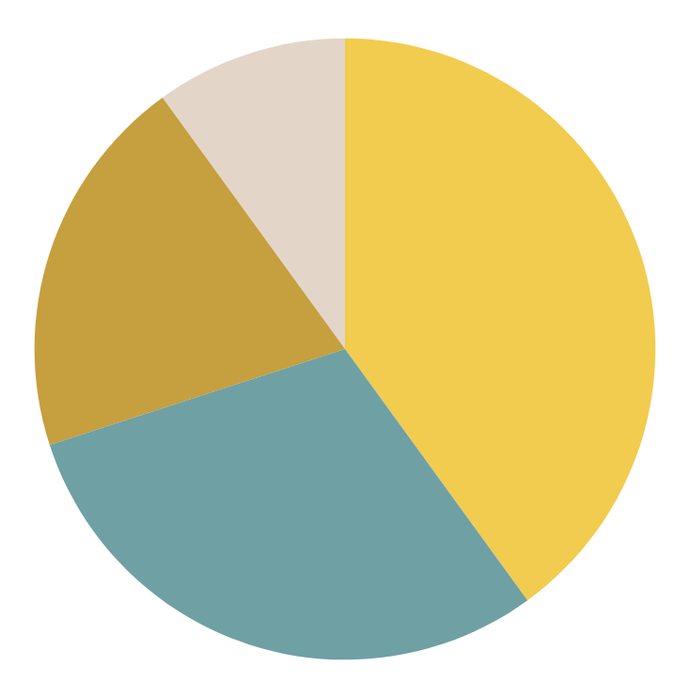
EMOTIONAL LONELINESS FIRST AID INFOGRAPHICS
EMOTIONAL
CHRONIC
Jupiter is a gas giant and the biggest planet
Venus is the second planet from the Sun
10%
40%
SOCIAL
SITUATIONAL
Mercury is the closest planet to the Sun
Despite being red, Mars is a cold place
20%
30%
Follow the link in the graph to modify its data and then paste the new one here. For more info, click here

Slide 28
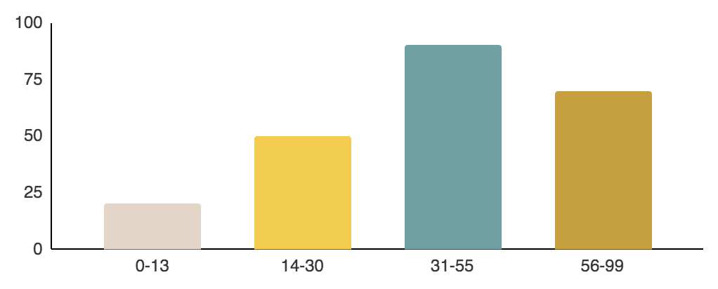
EMOTIONAL LONELINESS FIRST AID INFOGRAPHICS
AGE
GENDER
VENUS
EARTH
MARS
20%
50%
90%
70%
45%
30%
25%
Follow the link in the graph to modify its data and then paste the new one here. For more info, click here

Slide 29
EMOTIONAL LONELINESS FIRST AID INFOGRAPHICS
CAUSES
3/5
2/5
4/5
MERCURY
JUPITER
MARS
Mercury is the closest planet to the Sun and the smallest one
Jupiter is a gas giant and the biggest planet in the Solar System
Despite being red, Mars is a very cold place full of iron oxide dust

Slide 30
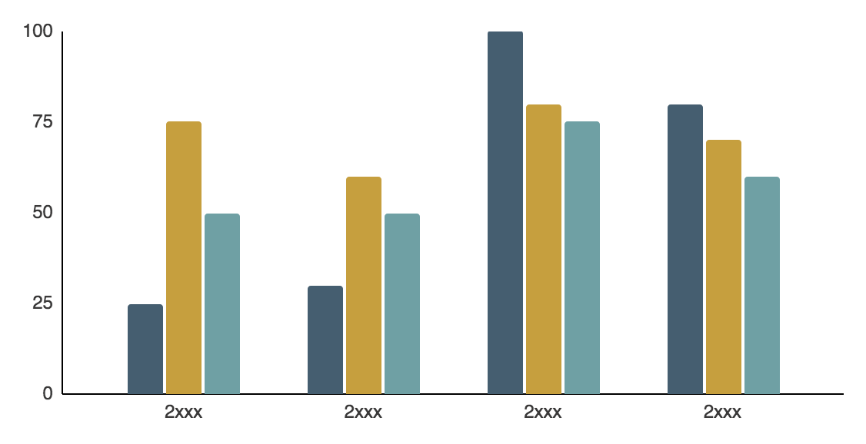
EMOTIONAL LONELINESS FIRST AID INFOGRAPHICS
FIRST AID
Despite being red, Mars is a very cold place
JUPITER
MERCURY
VENUS
Follow the link in the graph to modify its data and then paste the new one here. For more info, click here

Slide 31
EMOTIONAL LONELINESS FIRST AID INFOGRAPHICS
SATURN
Saturn is a gas giant and has several rings. It's composed of hydrogen and helium
75%
25%
MERCURY
Mercury is the closest planet to the Sun and the smallest one in the entire Solar System

Slide 32
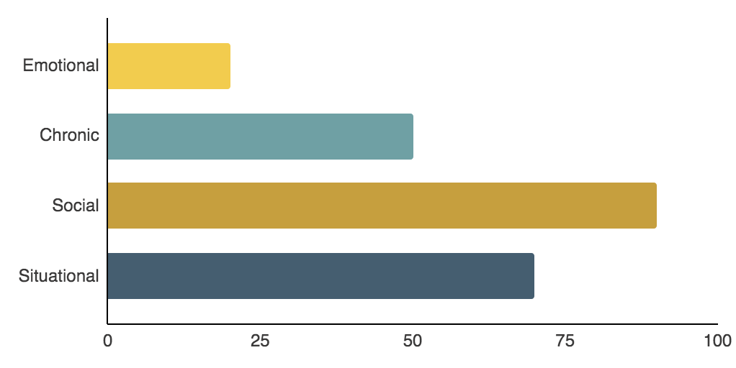
EMOTIONAL LONELINESS FIRST AID INFOGRAPHICS
TYPES OF LONELINESS
20%
Mercury is the smallest planet
50%
Despite being red, Mars is cold
80%
Jupiter is the biggest planet
70%
Saturn is a gas giant with rings
Follow the link in the graph to modify its data and then paste the new one here. For more info, click here

Slide 33
Instructions for use
If you have a free account, in order to use this template, you must credit Slidesgo in your final presentation. Please refer to the next slide to read the instructions for premium users.
As a Free user, you are allowed to:
- Modify this template.
- Use it for both personal and commercial projects.
You are not allowed to:
- Sublicense, sell or rent any of Slidesgo Content (or a modified version of Slidesgo Content).
- Distribute Slidesgo Content unless it has been expressly authorized by Slidesgo.
- Include Slidesgo Content in an online or offline database or file.
- Offer Slidesgo templates (or modified versions of Slidesgo templates) for download.
- Acquire the copyright of Slidesgo Content.
For more information about editing slides, please read our FAQs or visit our blog:
https://slidesgo.com/faqs and https://slidesgo.com/slidesgo-school

Slide 34
Instructions for use (premium users)
As a Premium user, you can use this template without attributing Slidesgo.
You are allowed to:
Modify this template.
Use it for both personal and commercial purposes.
Share this template in an editable format with people who are not part of your team.
You are not allowed to:
Sublicense, sell or rent this Slidesgo Template (or a modified version of this Slidesgo Template).
Distribute this Slidesgo Template (or a modified version of this Slidesgo Template) or include it in a database or in any other product or service that offers downloadable images, icons or presentations that may be subject to distribution or resale.
Use any of the elements that are part of this Slidesgo Template in an isolated and separated way from this Template.
Register any of the elements that are part of this template as a trademark or logo, or register it as a work in an intellectual property registry or similar.
For more information about editing slides, please read our FAQs or visit our blog:
https://slidesgo.com/faqs and https://slidesgo.com/slidesgo-school

Slide 35
Infographics
You can add and edit some infographics to your presentation to present your data in a visual way.
Choose your favourite infographic and insert it in your presentation using Ctrl C + Ctrl V or Cmd C + Cmd V in Mac.
Select one of the parts and ungroup it by right-clicking and choosing “Ungroup”.
Change the color by clicking on the paint bucket.
Then resize the element by clicking and dragging one of the square-shaped points of its bounding box (the cursor should look like a double-headed arrow). Remember to hold Shift while dragging to keep the proportions.
Group the elements again by selecting them, right-clicking and choosing “Group”.
Repeat the steps above with the other parts and when you’re done editing, copy the end result and paste it into your presentation.
Remember to choose the “Keep source formatting” option so that it keeps the design. For more info, please visit our blog.

